Slide 1

Introduction to Deep Learning with TensorFlow and Python
Author: Dylan Cunningham
Advisor: Qiwei Gan, PhD

Slide 2
Debrief
Learning Deep Learning
Applications and Real-World Examples
Brief History
Neural Networks
Deep Learning Concepts
References and External Sources
Applying Deep Learning
See IPython notebook
Notes:
There are two parts to this lesson on deep learning. The first is this PowerPoint slide. The second is the IPython notebook.

Slide 3
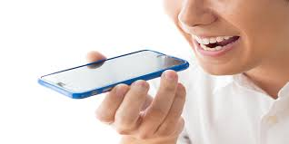
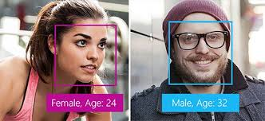
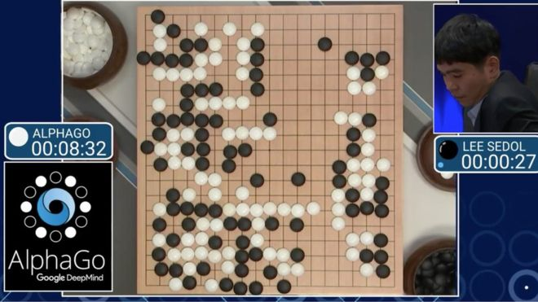

Application and Real-World Examples
Notes:
ANN are versatile, scalable, and powerful, which makes them ideal for large, complex (even non-linear) ML tasks: computer vision, phonetic recognition, voice search, conversational speech recognition, speech and image feature coding, semantic utterance classification, hand-writing recognition, audio processing, visual object recognition, information retrieval, in the analysis of molecules that may lead to discovering new drugs, classifying billions of images, recommending the best videos to watch to hundreds of millions of users every day, learning to beat the world champion in the game of Chess or Go, and even powering common ML tasks when there is a lot of data.

Slide 4
Applications and Real-World Examples
Brief History
Neural Networks
Deep Learning Concepts
References and External Sources

Slide 5
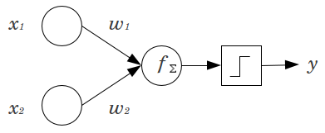
Brief History
Artificial neural networks (ANNs) first emerged in 1943; the first architecture (a perceptron) was proposed by neurophysiologist Warren McCulloch and a mathematician Walter Pitts.
Notes:
Don’t need to explain the graphic at this point.

Slide 6
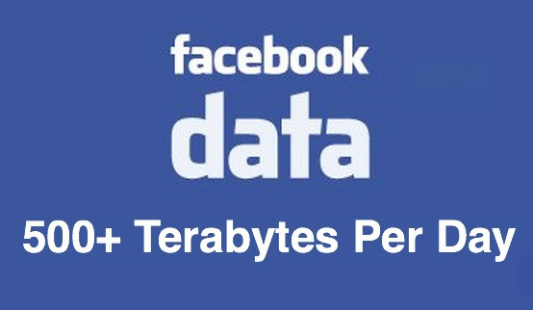
Brief History
ANNs died for 20 years from the 60s to the 80s. There are several reasons to believe they will NOT die again:
There is now a ton of data to train ANNs
ANNs generally outperform traditional ML models on larger, more complex problems
Computing resources have significantly advanced since the 1900s—resources are less expensive
ANN architectures and functions have improved only slightly, yet powerfully
Some theoretical limitations have been found to be benign in practice

Slide 7
Applications and Real-World Examples
Brief History
Neural Networks
Deep Learning Concepts
References and External Sources

Slide 8
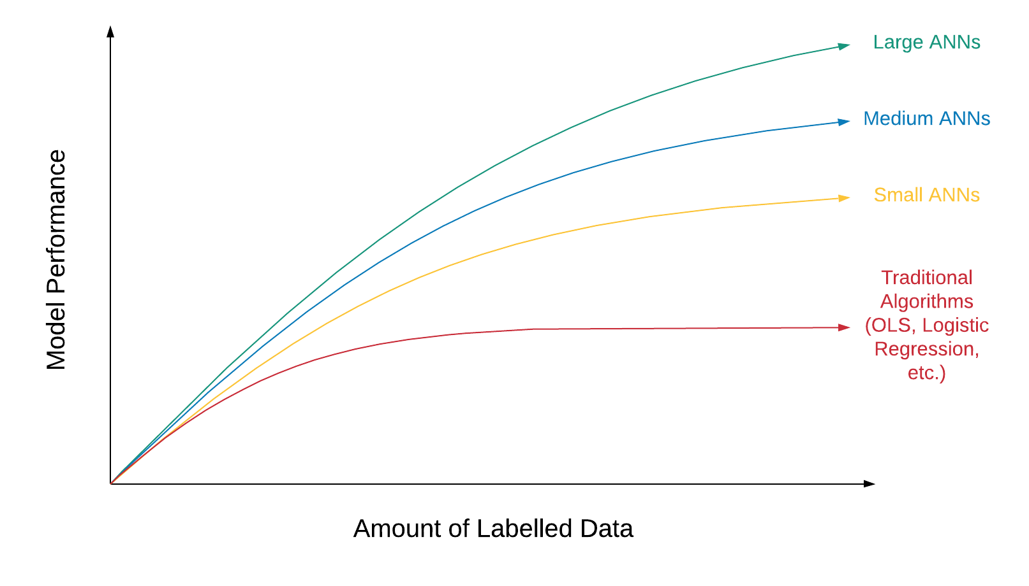
Neural Networks
Notes:
Scale drives neural network performance

Slide 9
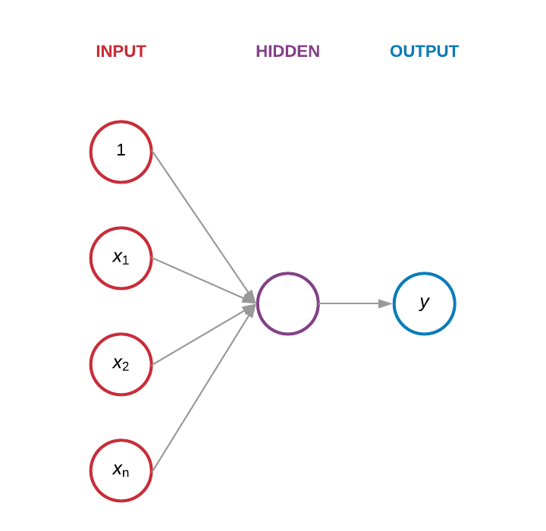
Neural Networks
Notes:
The oldest neural network (NN) architecture was called a perceptron. It receives input and outputs a result.

Slide 10
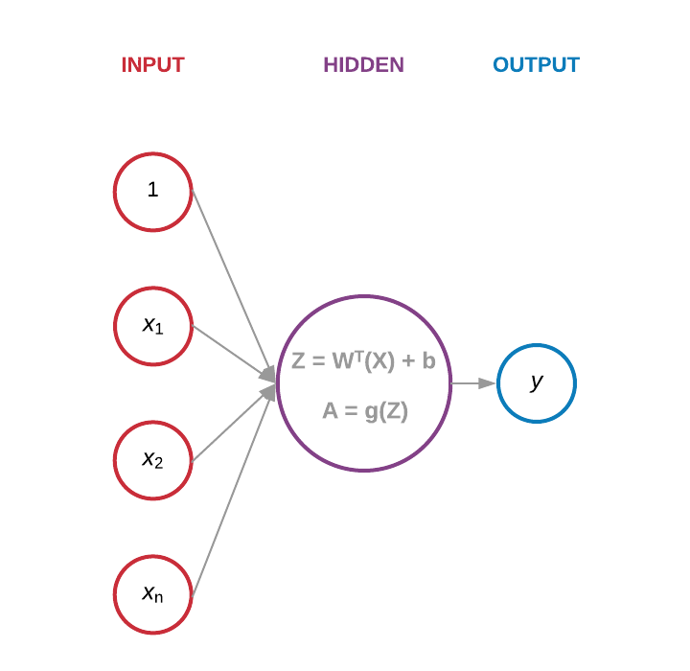
Neural Networks
Notes:
Perceptron showing that at each node a calculation is being made using the Weights (W), Input (X), Bias Term (b), and a Function (g)
The g function, the calculation of A (activation function) is talked about on the next slide.

Slide 11
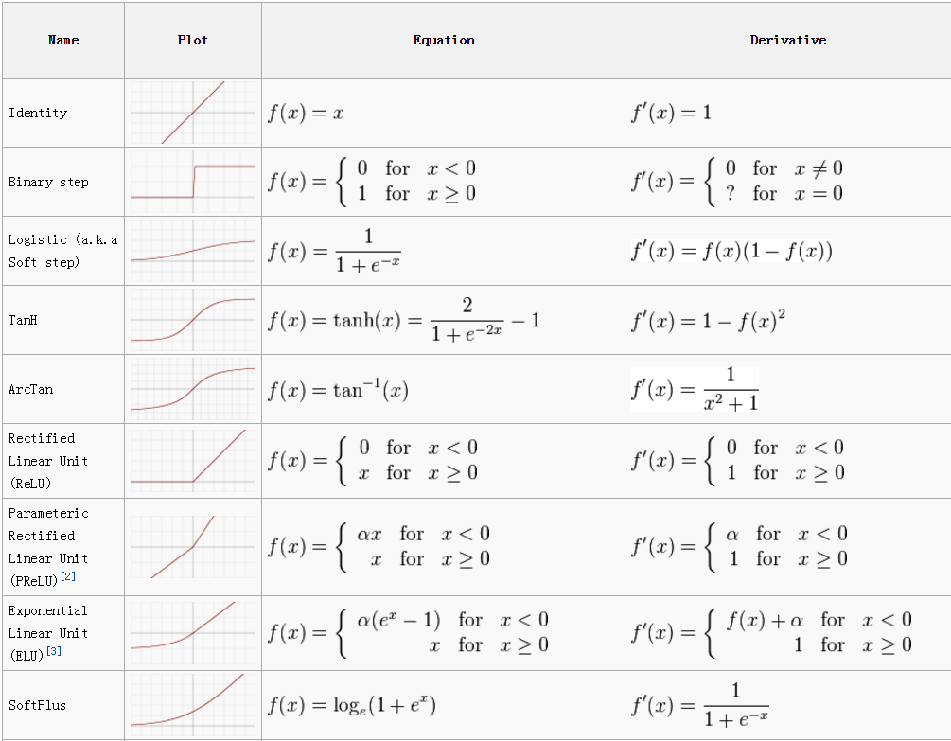
Neural Networks
Notes:
Many, not comprehensive, activation functions.

Slide 12
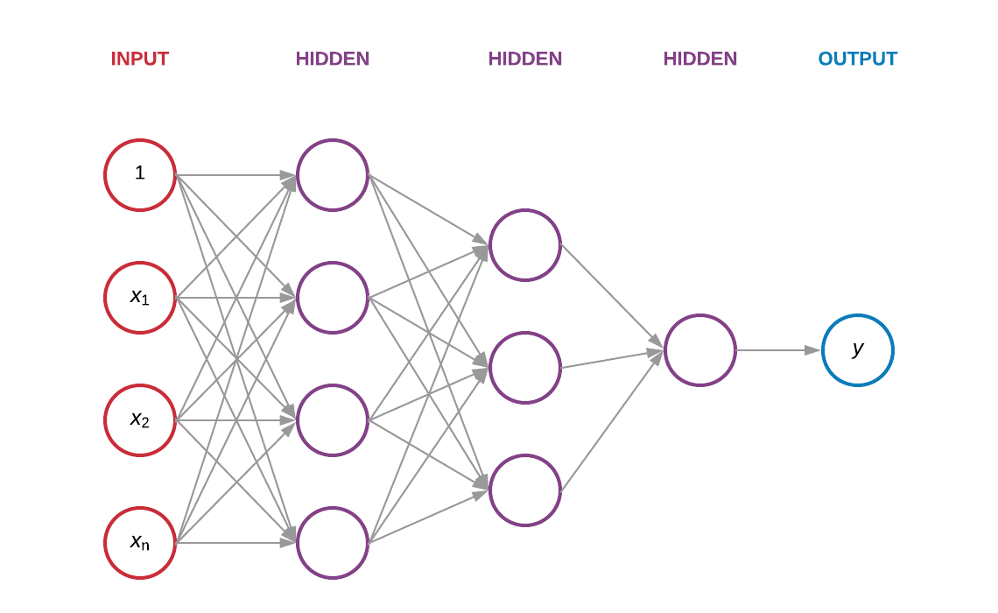
Neural Networks
Notes:
The next NN architecture is the multi-layer perceptron. It is almost exactly like the perceptron—it receives input and outputs a result. Except now it has more computing steps, which are called hidden layers.

Slide 13
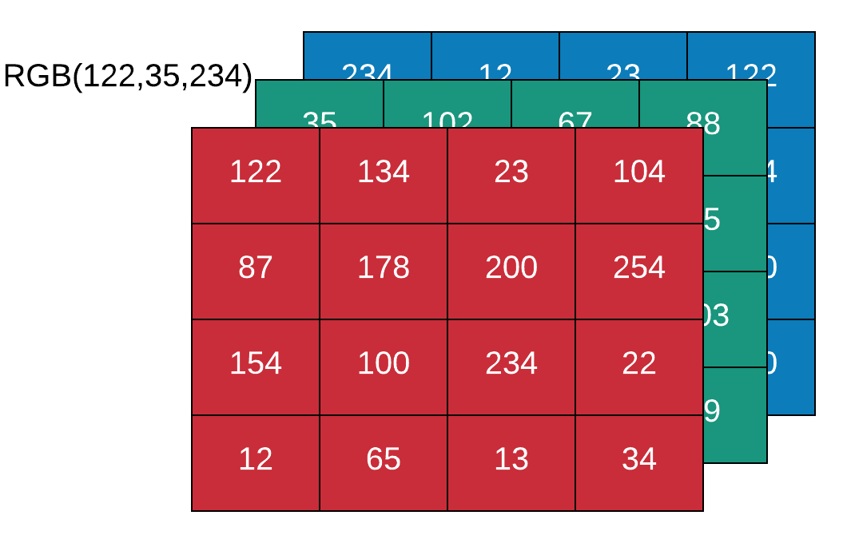
Neural Networks
Convolutional NN
Notes:
CNNs are good for image recognition tasks

Slide 14
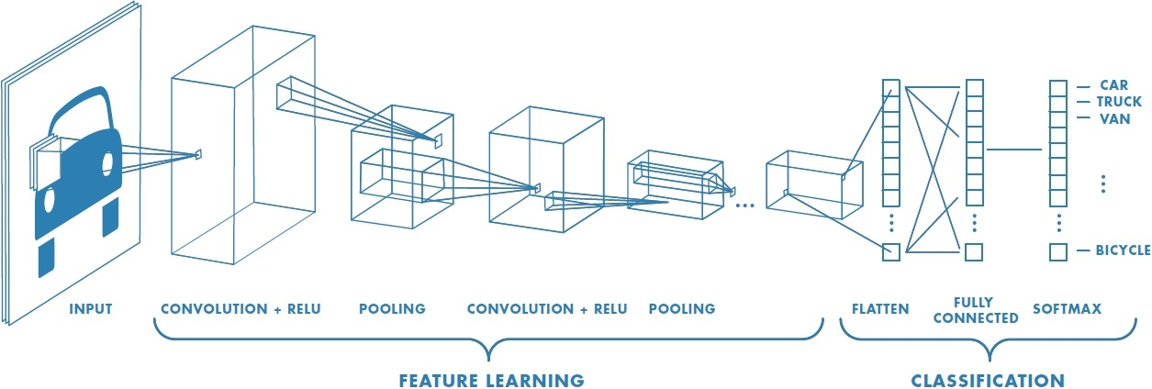
Neural Networks
Convolutional NN

Slide 15
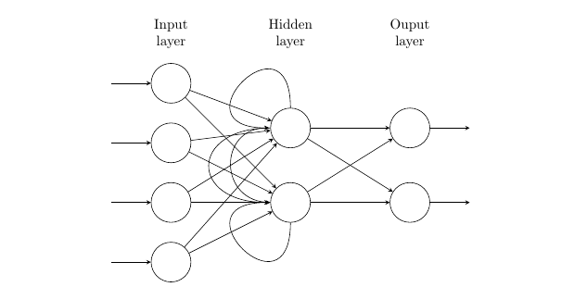
Neural Networks
Recurrent NN
Notes:
RNNs are good for sequence tasks: time series, NLP, speech recognition, translation

Slide 16
Applications and Real-World Examples
Brief History
Neural Networks
Deep Learning Concepts
References and External Sources

Slide 17
Deep Learning Concepts
Deep learning
Neural networks are defined as deep learning if they have more than one hidden layer. Each hidden layer contains one or more points to receive input; these points are called neurons or nodes.

Slide 18
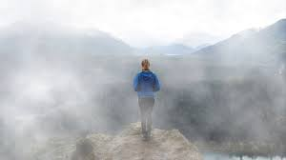
Deep Learning Concepts
Gradient descent
Notes:
Suppose you are lost in the mountains in a dense fog; you can only feel the slope of the ground below your feet. A good strategy to get to the bottom of the valley quickly is to go downhill in the direction of the steepest slope. This is exactly what Gradient Descent does.

Slide 19
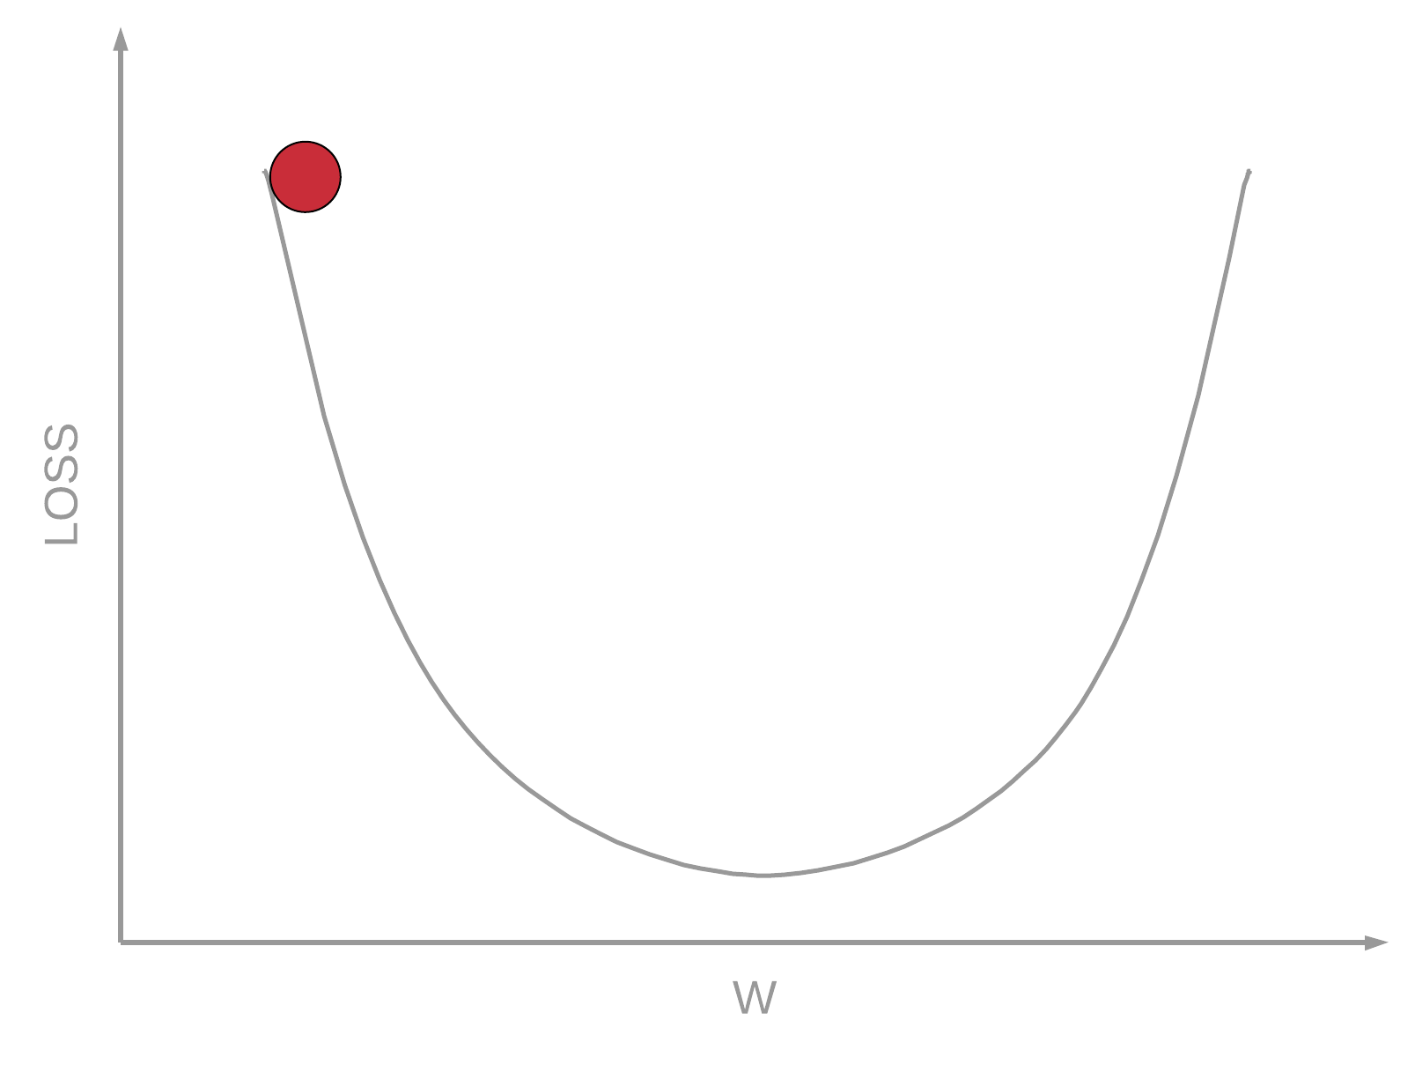
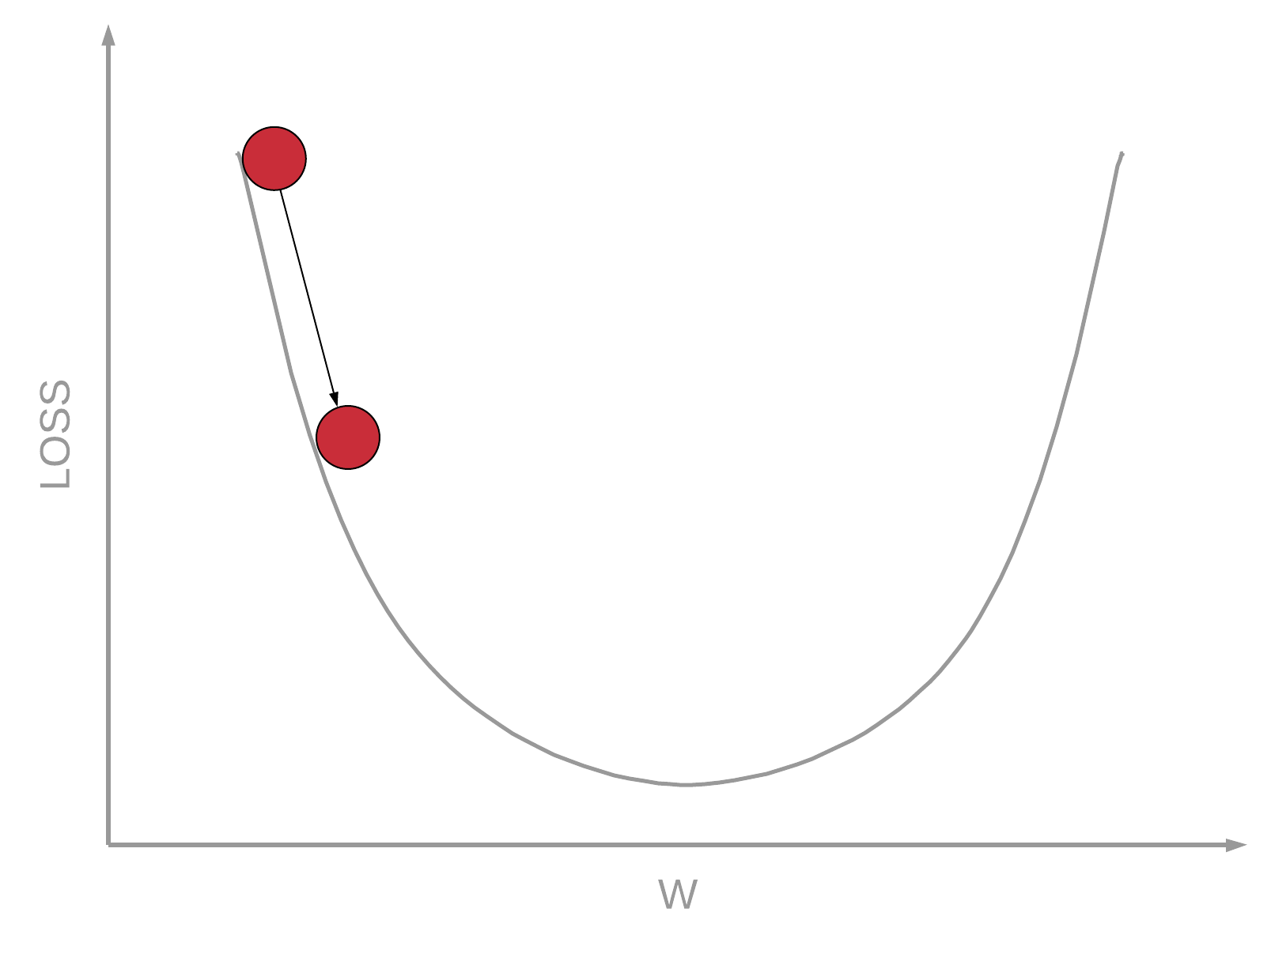
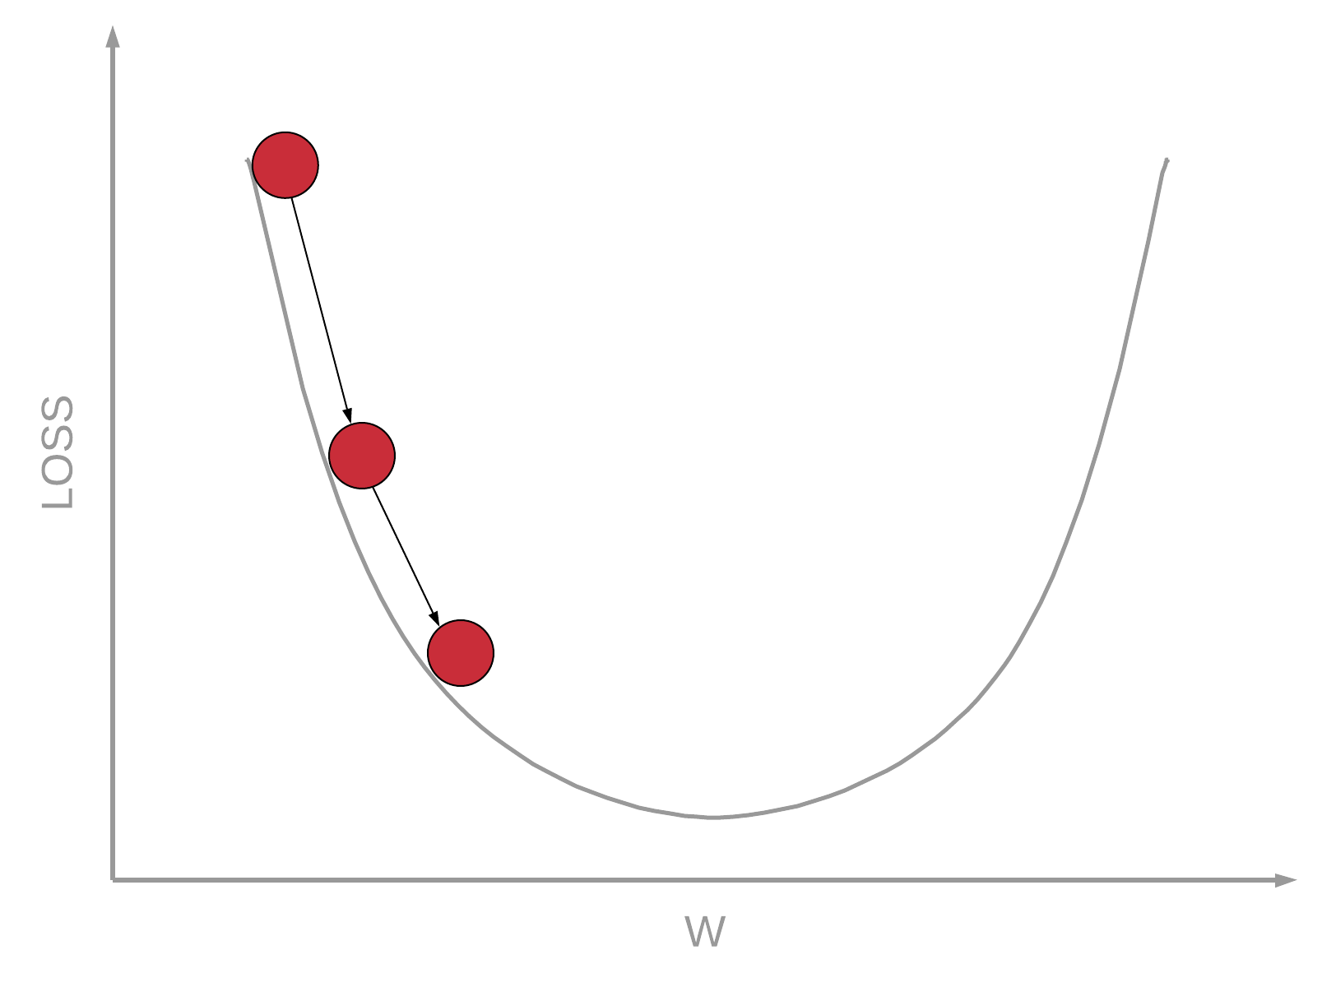
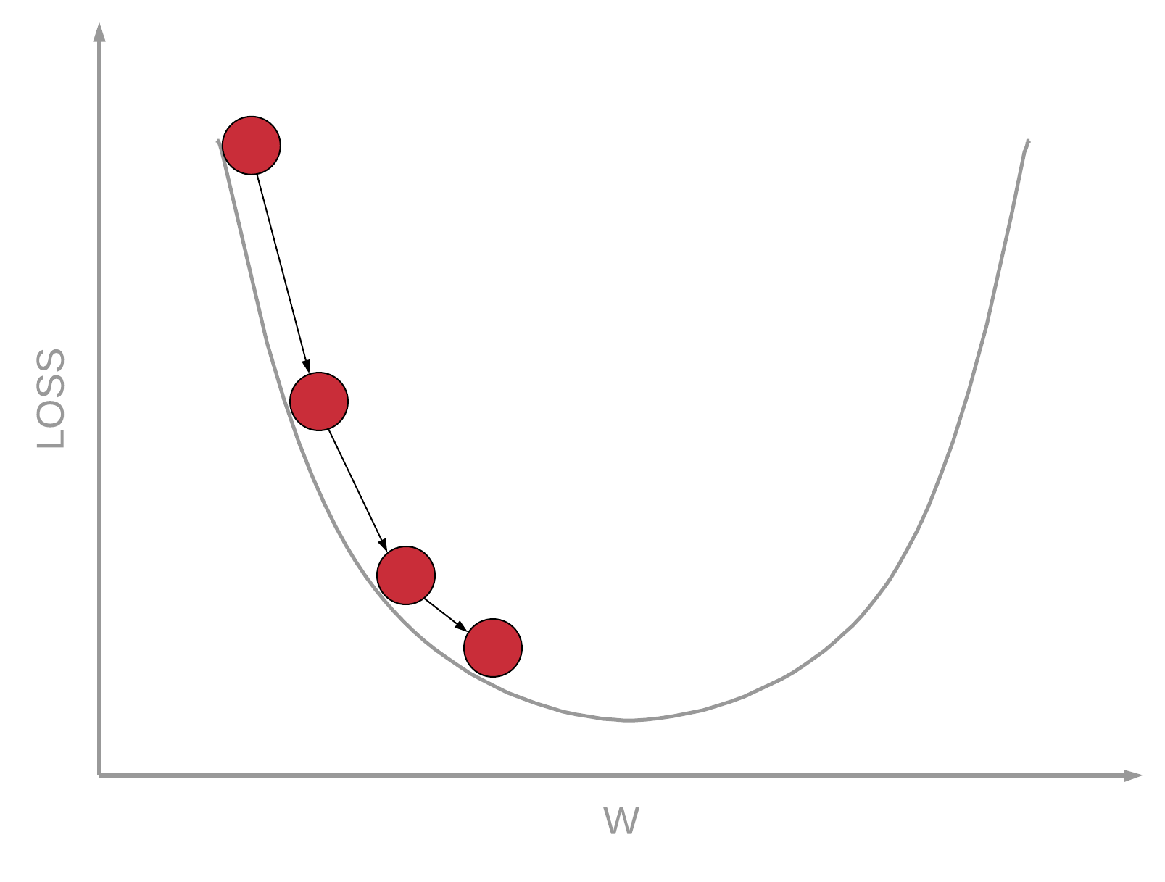
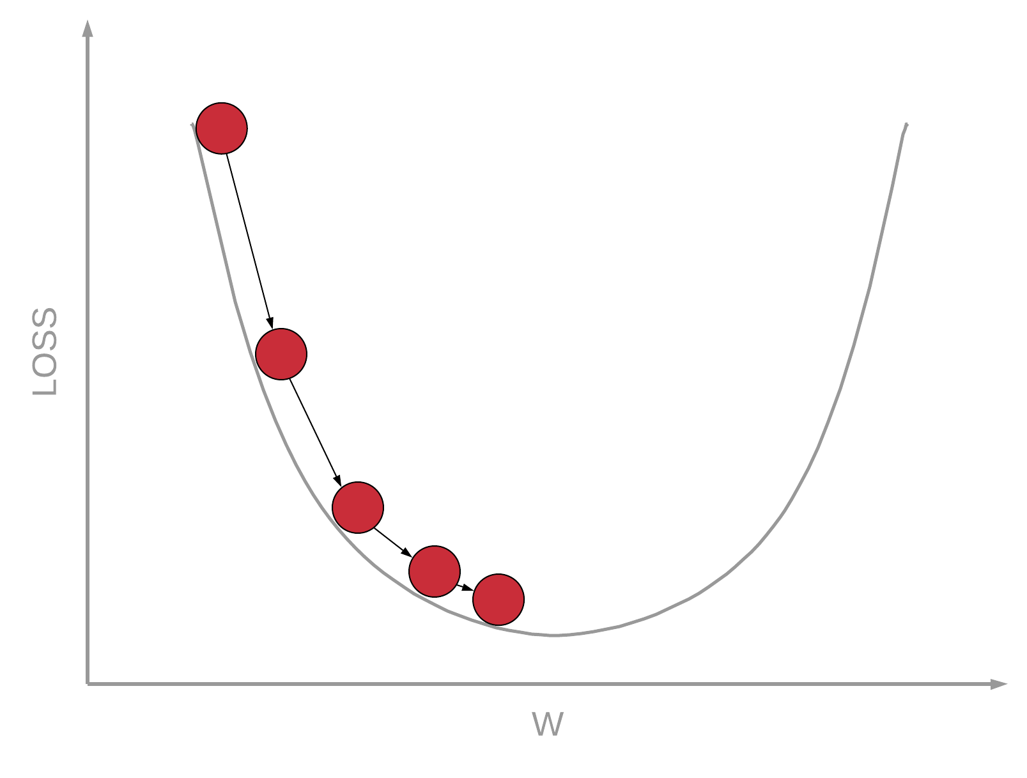
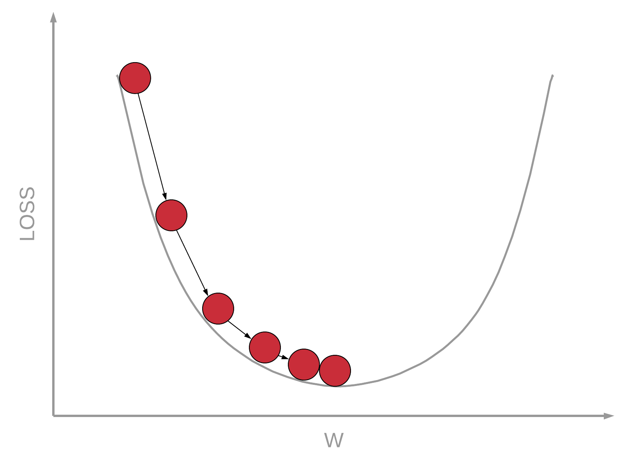
Deep Learning Concepts
Gradient descent
The general idea is to tweak parameters iteratively in order to minimize a cost function.
Notes:
*Look at this slide in presentation mode to see its effects

Slide 20
Deep Learning Concepts
Cost function
How can you know which values of a machine learning model perform best?
You can either use a utility function that measures how good your model is, or you can define a cost function that measures how bad it is
In deep learning, we use a cost function to measure how bad our model represents the input data.
Notes:
Draw the equation y = mx + b in the white space in the middle of the slide and explain that for linear regression the values “m” and “b” change to optimally represent (i.e., optimally model) the given data (x).

Slide 21
Deep Learning Concepts
Learning rate
Notes:
*Look at this slide in presentation mode to see its effects

Slide 22
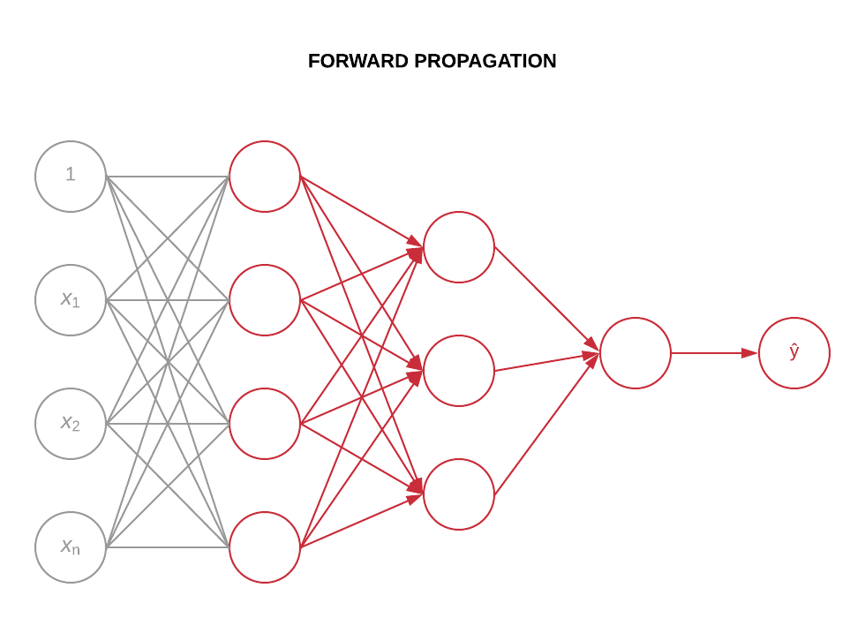
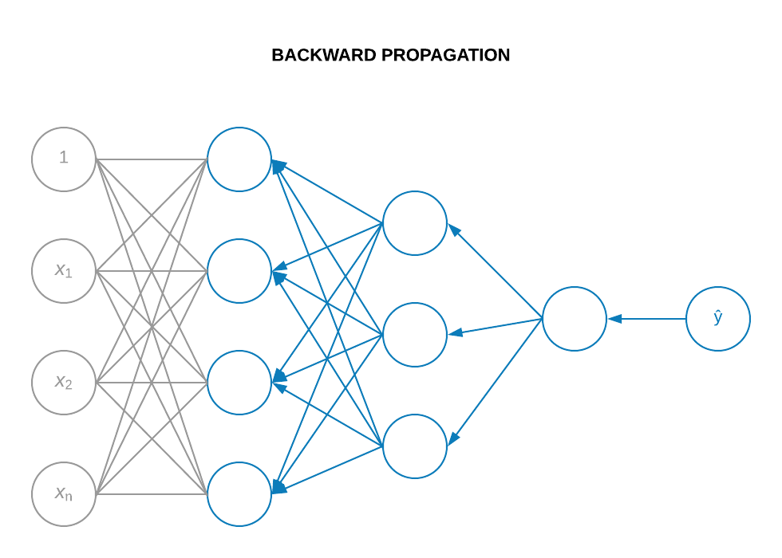
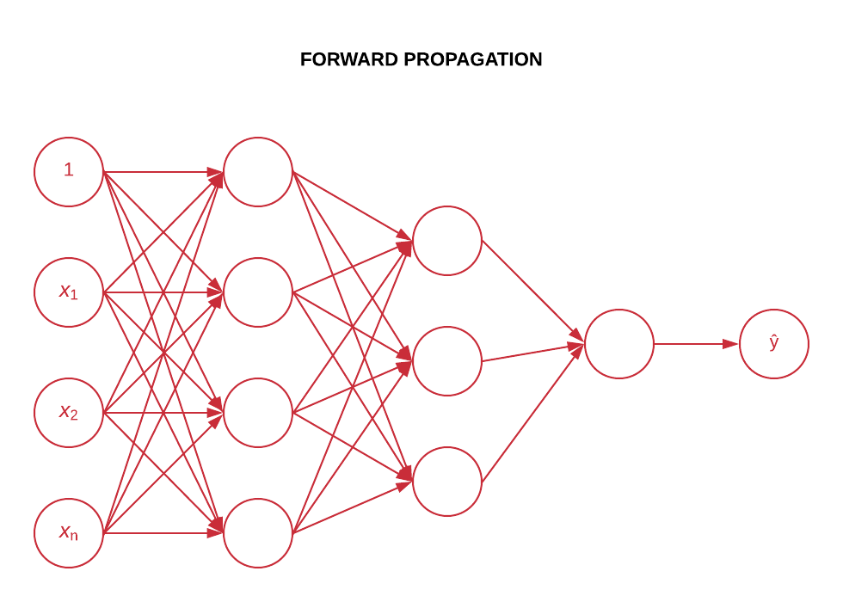
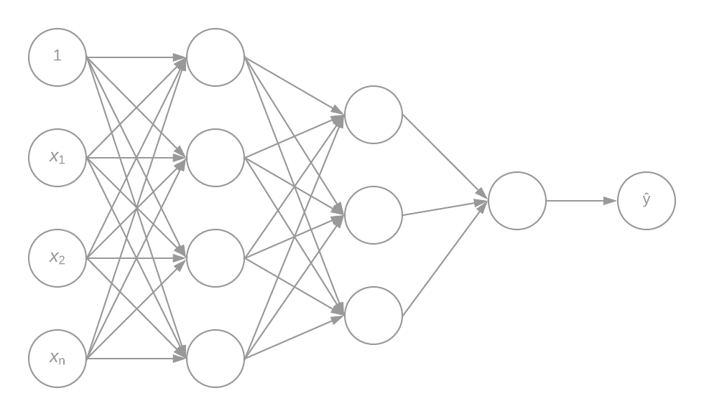
Deep Learning Concepts
Propagation
Notes:
Deep learning NNs not only receive input, send that input through hidden nodes with possibly many layers, and produce output (a forward step), they also iterate through the nodes and hidden layers backwards (a backward step).
The forward step is called forward propagation. The backward step is called backward propagation. Between forward and backward propagation, the output of the NN is evaluated (i.e., a computation is made to know how well the NN can predict).
This process is iterated over and over until the NN can predict well.

Slide 23
Applications and Real-World Examples
Brief History
Neural Networks
Deep Learning Concepts
References and External Sources

Slide 24
References
Individualized teaching by Dr. Qiwei Gan
Hands-On Machine Learning with Scikit-Learn and TensorFlow by Aurelien Geron
DeepLearning.ai Coursera.org specialization by Andrew Ng
A Tutorial Survey of Architectures, Algorithms, and Applications for Deep Learning by Li Deng

Slide 25
External Sources
Books:
Hands-On Machine Learning with Scikit-Learn and TensorFlow by Aurelien Geron ($20)
Online courses:
Deep Learning Specialization by Andrew Ng (Coursera)
Deep Learning by Google (Udacity)
Online repositories:
Hands-on Machine Learning (Github)

